Slide 1
Exit Strategies
SE495: Software Entrepreneurship

Slide 2
Outline
Introduction
Types of Exit Strategies
Factors to Consider When Choosing an Exit Strategy
Preparing for an Exit Strategy
Case Studies of Successful Exit Strategies

Slide 3
Introduction

Slide 4
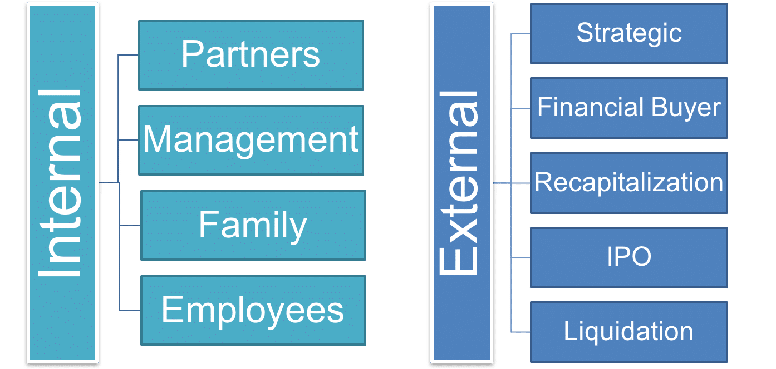
Introduction to Exit Strategies
Exit strategies refer to the plans and strategies devised by startups to sell or transfer their ownership to another entity.
It involves determining how and when the startup will exit the market, either through an acquisition, merger, initial public offering (IPO), or other means of transferring ownership.

Slide 5
Introduction to Exit Strategies
Exit strategies are crucial for investors and founders to realize a return on their investment.
Exit strategies can be categorized into two main types:
Financial
Strategic

Slide 6
Importance of Considering Exit Strategies
Maximizing value for shareholders and founders
Providing a clear roadmap
Mitigating risks
Attracting investors and strategic partners
Facilitating succession planning

Slide 7
Overview of Different Types of Exit Strategies
Financial exit strategies:
Initial Public Offering (IPO)
A company goes public and issues stocks to raise capital.
Mergers and Acquisitions (M&A)
A company is acquired by another business or investor.
Venture Capital (VC) Exit
A VC firm sells its stake in a company to another investor or through an IPO.

Slide 8
Overview of Different Types of Exit Strategies
Strategic exit strategies:
Partnership or Collaboration
A company partners with another business to expand its offerings or reach new markets.
Joint Venture
A company creates a new entity with another business to jointly own and operate a specific project or business line.
Spin-Off
A company separates a part of its business into a new entity, which can be sold or taken public.

Slide 9
Factors to Consider When Choosing an Exit Strategy
Company stage and size.
Industry and market conditions.
Financial performance and growth potential.
Competition and market share.
Legal and regulatory requirements.

Slide 10
Types of Exit Strategies

Slide 11
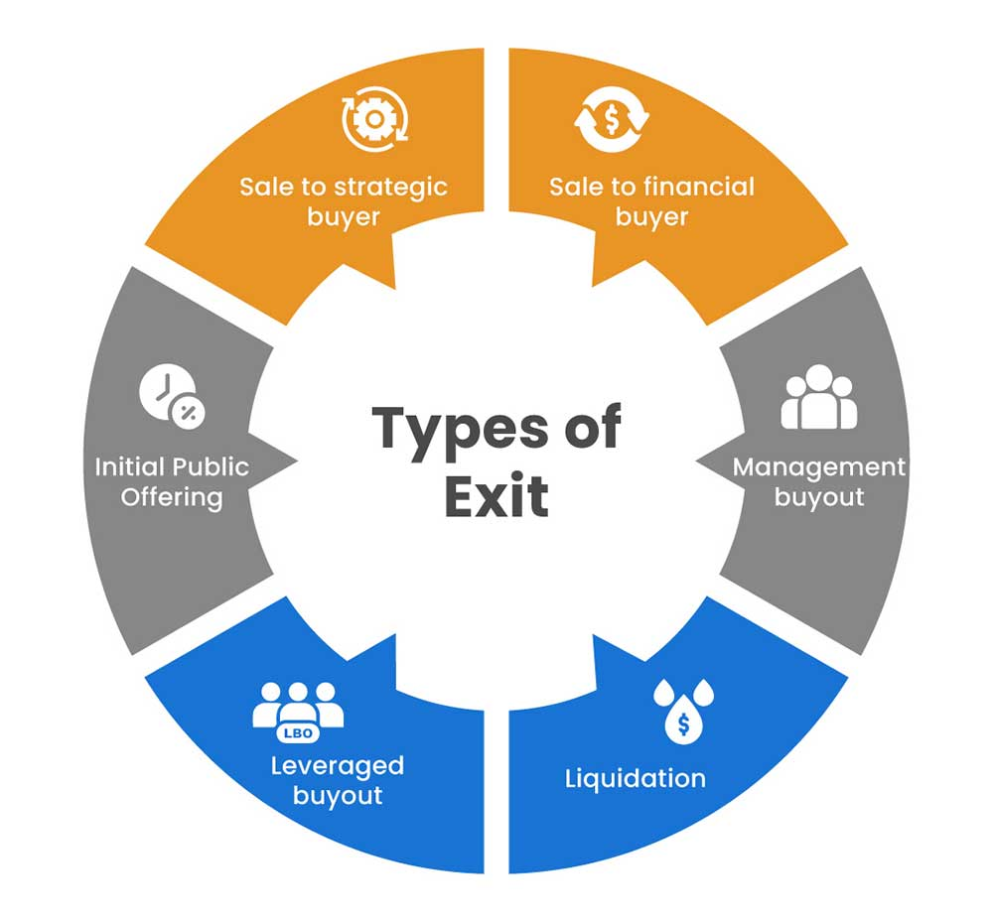
Types of Exit Strategies
Mergers and Acquisitions (M&A)
Initial Public Offering (IPO)
Strategic Partnerships
Spin-Offs
Liquidation

Slide 12
Mergers and Acquisitions (M&A)
Refer to the process of combining two or more companies into a single entity.
M&A can involve the acquisition of a company by another company, or the merger of two or more companies to form a new entity.
M&A can be done for various reasons, including expanding market share, acquiring new technologies, increasing efficiency, and gaining access to new markets.

Slide 13
Advantages of M&A
Increased market share and revenue
Access to new technologies and intellectual property
Cost savings through synergies and economies of scale
Enhanced competitiveness and market position
Diversification of products and services
Access to new markets and customers

Slide 14
Disadvantages of M&A
Integration challenges and cultural differences
Risk of overpayment for the acquisition
Potential loss of key employees and customers
Difficulty in achieving expected synergies and cost savings
Risk of negative impact on brand reputation and customer loyalty
Potential legal and regulatory issues

Slide 15
Examples of Successful M&A Exit Strategies
Microsoft's acquisition of LinkedIn for $26.2 billion in 2016
Salesforce's acquisition of ExactTarget for $2.5 billion in 2013
Oracle's acquisition of NetSuite for $9.3 billion in 2016
Symantec's acquisition of Blue Coat for $4.65 billion in 2016
IBM's acquisition of Red Hat for $34 billion in 2018
Zoom acquired Five9 for $14.7 billion in 2020

Slide 16
Initial Public Offering (IPO)
The process of a privately held company raising capital by selling its shares to the public for the first time.
IPO is a significant milestone for any company, as it allows the company to raise capital, increase its visibility, and attract new investors.
IPO involves the issuance of new shares to the public, and the company receives the funds raised from the sale of these shares.

Slide 17
Advantages of IPO
Access to capital
Increased visibility
Liquidity
Enhanced credibility

Slide 18
Disadvantages of IPO
High costs
Time-consuming
Loss of control
Risk of dilution

Slide 19
Examples of Successful IPO Exit Strategies
Microsoft's IPO in 1986, which raised $61 million and valued the company at $780 million.
Google's IPO in 2004, which raised $1.67 billion and valued the company at $23 billion.
Facebook's IPO in 2012, which raised $16 billion and valued the company at $104 billion.
Uber's IPO in 2019, which raised $8.1 billion and valued the company at $80 billion.
Airbnb's IPO in 2020, which raised $3.5 billion and valued the company at $112 billion.

Slide 20
Examples of Successful IPO Exit Strategies
In 2022, Jahez, a Saudi food delivery and online marketplace, listed on the Tadawul through an IPO, raising SAR 1.1 billion (approximately USD 293 million). The IPO was oversubscribed by 205%.
Nana plans to go public in the Saudi market in 2025 after raising SAR 500 million ($133 million) in funding to support its expansion plans across Saudi Arabia and neighboring countries, with the goal of capturing a larger share of the SAR 200 billion Saudi grocery market, where online sales are expected to grow significantly.

Slide 21
Acquisition vs IPO Pathways
Feature | Acquisition | IPO
Goal | To grow by acquiring another company | To raise capital by selling shares of stock to the public
Process | Complex and risky | Challenging but can be rewarding
Outcome | The acquiring company gains control of the acquired company's assets, liabilities, and business operations | The company's stock becomes more liquid and it has the capital it needs to grow

Slide 22
Acquisition vs IPO Pathways
Feature | Acquisition | IPO
Goal | To grow by acquiring another company | To raise capital by selling shares of stock to the public
Process | Complex and risky | Challenging but can be rewarding
Outcome | The acquiring company gains control of the acquired company's assets, liabilities, and business operations | The company's stock becomes more liquid and it has the capital it needs to grow

Slide 23
Acquisition vs IPO Pathways
Acquisition:
Pros:
Higher Valuation
Resources and Expertise
Exit Opportunity
Cons:
Loss of Control
Cultural Integration
Merger Challenges

Slide 24
Acquisition vs IPO Pathways
IPO:
Pros:
Liquidity and Fundraising
Enhanced Visibility and Credibility
M&A Currency
Cons:
Regulatory Compliance
Market Volatility and Investor Scrutiny
Loss of Privacy

Slide 25
Strategic Partnerships
Refer to collaborative agreements between two or more businesses to achieve specific goals or objectives.
These partnerships can be formed for various reasons, such as to access new markets, technologies, or customers, or to jointly develop new products or services.
Strategic partnerships can be formal or informal, and can involve various levels of commitment and resource sharing.

Slide 26
Advantages of Strategic Partnerships
Access to new markets, technologies, or customers
Shared resources and costs
Increased competitiveness and market share
Improved product or service offerings
Enhanced credibility and reputation
Opportunities for joint research and development

Slide 27
Disadvantages of Strategic Partnerships
Loss of control and autonomy
Dependence on partners for success
Potential conflicts and disagreements
Difficulty in aligning goals and objectives
Risk of intellectual property theft or misuse
Potential for negative impact on brand reputation

Slide 28
Successful Strategic Partnership Exit Strategies
Microsoft and Nokia's partnership to develop Windows Phone.
Apple and Intel's partnership to develop the iPhone.
Google and Android's partnership to develop the Android operating system.
Amazon and BMW's partnership to integrate Alexa into BMW's vehicles.
Salesforce and Microsoft's partnership to integrate Salesforce's CRM with Microsoft's Azure and Office 365.

Slide 29
Successful Strategic Partnership Exit Strategies
Acquisition by a Local Conglomerate
Uber's acquisition of Careem in 2019 for $3.1 billion, with a significant presence in Saudi Arabia.
Strategic Sale to a Regional Player
The sale of Saudi-based online retailer Souq.com to Amazon in 2017 for $580 million.

Slide 30

Spin-Offs
A spin-off is a new company that is created by separating a part of an existing company, such as a business unit, product line, or technology.
The existing company, known as the parent company, spin-offs the new company by transferring assets, employees, and intellectual property to the new entity.
Spin-offs can be formed to focus on a specific market or technology, or to create a separate entity for a product or service that is not core to the parent company's business.

Slide 31
Spin-Offs
Spin-offs can offer several advantages, including:
Focus
Increased value
Autonomy
Attractiveness to investors
Spin-offs can also have some disadvantages, including:
Risk
Lack of scale
Dependence on parent company
Difficulty in attracting talent

Slide 32
Examples of Successful Spin-Off Exit Strategies
Google's spin-off of Calico, a life sciences company focused on aging and longevity.
Apple's spin-off of Beats Electronics, a audio products company.
Amazon's spin-off of AWS, a cloud computing platform.
Microsoft's spin-off of LinkedIn, a professional networking platform.
Oracle's spin-off of NetSuite, a cloud-based business management software company.

Slide 33
Examples of Successful Spin-Off Exit Strategies
Carve-Out of a Specific Product or Service Line
Saudi Telecom Company's (STC) carve-out of its data center business into a separate entity, STC Data Centers.
Spin-Off of a Research and Development (R&D) Unit
King Abdullah University of Science and Technology (KAUST)'s spin-off of its R&D unit, KAUST Innovation, into a separate entity.

Slide 34
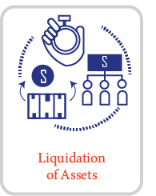
Liquidation
The process of selling off a company's assets, such as property, equipment, and intellectual property, to convert them into cash or pay off debts.
Liquidation can be voluntary, where the company chooses to liquidate its assets, or involuntary, where a court or creditor forces the company into liquidation.
Liquidation can be used to wind up a company's operations, pay off debts, or distribute assets to shareholders.

Slide 35
Liquidation
Liquidation can offer several advantages, including:
Quickly converting assets into cash
Reducing debt
Closing down operations
Distribution to shareholders
Liquidation can also have some disadvantages, including:
Loss of control
Limited return
Negative impact on employees
Negative impact on reputation

Slide 36
Examples of Successful Liquidation Exit Strategies
Microsoft's liquidation of its smartphone business, which allowed the company to focus on its core software business.
Yahoo's liquidation of its core internet business, which resulted in a successful exit for shareholders.
Hewlett-Packard's liquidation of its webOS business, which allowed the company to focus on its core hardware and software businesses.
IBM's liquidation of its PC business, which allowed the company to focus on its core software and services businesses.

Slide 37
Factors to Consider When Choosing an Exit Strategy

Slide 38
Factors to Consider When Choosing an Exit Strategy
Company goals and objectives
Market conditions
Financial performance
Competitive landscape
Team dynamics and considerations

Slide 39
Company Goals and Objectives
Importance of aligning exit strategy with company goals and objectives
Examples of company goals and objectives that may influence exit strategy:
Revenue growth
Market share
Innovation
Customer satisfaction
Financial performance

Slide 40
Market Conditions
Importance of considering market conditions when choosing an exit strategy
Examples of market conditions that may influence exit strategy:
Market size and growth potential
Competition
Customer needs and preferences
Technological advancements
Economic conditions

Slide 41
Financial Performance
Importance of financial performance in choosing an exit strategy
Examples of financial metrics that may influence exit strategy:
Revenue
Profitability
Cash flow
Valuation
Return on investment (ROI)

Slide 42
Competitive Landscape
Importance of considering the competitive landscape when choosing an exit strategy
Examples of factors that may influence exit strategy:
Number of competitors
Competitor size and strength
Competitor market share
Competitor pricing and product offerings
Barriers to entry

Slide 43
Team Dynamics and Considerations
Importance of considering team dynamics and considerations when choosing an exit strategy
Examples of team dynamics and considerations that may influence exit strategy:
Team size and structure
Employee retention and turnover
Team expertise and skills
Team alignment with company goals and objectives
Employee ownership and equity

Slide 44
Preparing for an Exit Strategy

Slide 45
Preparing for an Exit Strategy
Building a strong management team
Developing a clear growth strategy
Ensuring financial stability
Enhancing the company's valuation
Preparing for due diligence

Slide 46
Building a Strong Management Team
Importance of having a strong management team in place
Reasons why a strong management team is critical for a successful exit:
Attractiveness to potential buyers
Ability to execute on growth plans
Increased valuation

Slide 47
Building a Strong Management Team
Tips for building a strong management team:
Hire experienced and skilled professionals
Develop a clear organizational structure
Provide training and development opportunities
Foster a positive company culture

Slide 48
Developing a Clear Growth Strategy
Importance of having a clear growth strategy in place
Reasons why a clear growth strategy is critical for a successful exit:
Provides direction and focus for the company
Demonstrates potential for future growth
Increases valuation
Tips for developing a clear growth strategy:
Conduct market research and analysis
Identify key growth drivers
Set realistic and achievable goals
Develop a plan for executing on the growth strategy

Slide 49
Ensuring Financial Stability
Importance of ensuring financial stability
Reasons why financial stability is critical for a successful exit:
Attractiveness to potential buyers
Ability to execute on growth plans
Increased valuation
Tips for ensuring financial stability:
Develop a solid financial plan
Manage cash flow effectively
Reduce debt and liabilities
Build a strong financial team

Slide 50
Preparing your company for acquisition
Financial Planning:
Accurate and Up-to-Date Financial Statements
Clean Up Financial Records
Financial Projections

Slide 51
Preparing your company for acquisition
Legal Planning:
Compliance with Laws and Regulations
Due Diligence Preparation
Non-disclosure Agreements

Slide 52
Preparing your company for acquisition
Operational Planning:
Streamline Operations
Customer and Employee Retention Plans
Integration Readiness

Slide 53
Enhancing the Company's Valuation
Importance of enhancing the company's valuation
Reasons why a higher valuation is critical for a successful exit:
Increased attractiveness to potential buyers
Increased potential for a higher sale price
Increased ability to negotiate favorable terms
Tips for enhancing the company's valuation:
Focus on revenue growth and profitability
Develop a strong intellectual property portfolio
Build a strong brand and reputation
Invest in technology and innovation

Slide 54
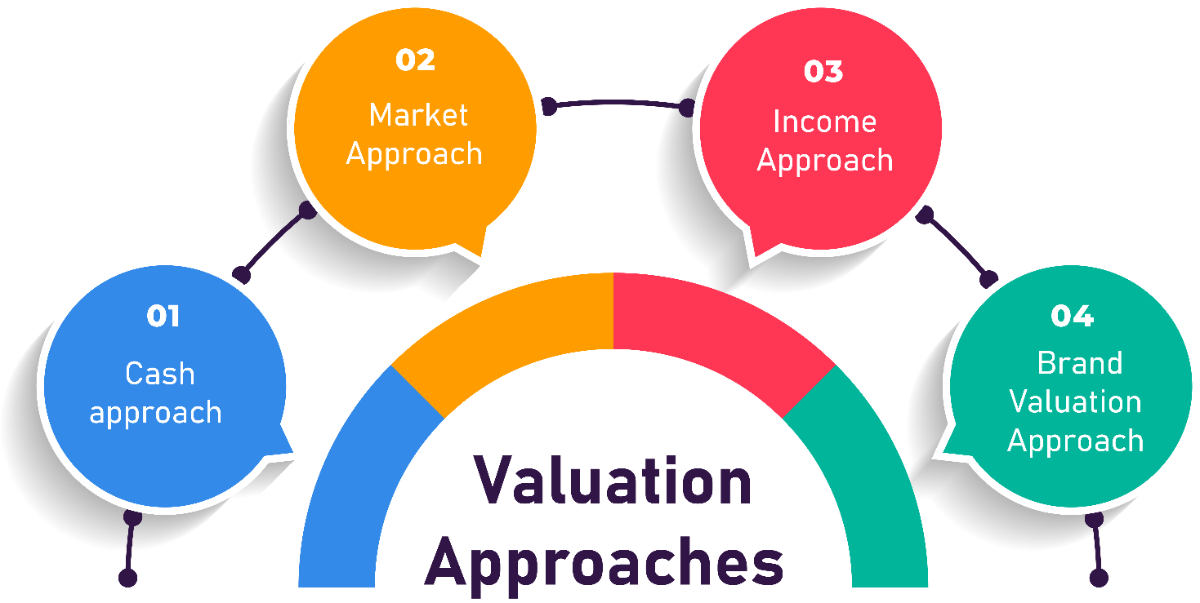
Valuation
Valuation is the process of determining the financial worth or fair value of a company, asset, or investment.
Several methods can be used to estimate the value of a company, including:
Discounted Cash Flow (DCF) Analysis
Comparable Company Analysis
Precedent Transaction Analysis

Slide 55
Valuation
Factors that can impact the valuation of a company include:
Revenue and Profitability
Market Size and Growth Potential
Competitive Landscape
Intellectual Property and Assets
Management Team and Talent
Risk Factors

Slide 56
Preparing for Due Diligence
Importance of preparing for due diligence
Reasons why due diligence is critical for a successful exit:
Provides transparency and credibility
Helps to identify potential issues and risks
Increases the likelihood of a successful exit
Tips for preparing for due diligence:
Conduct a thorough review of financial records and operations
Identify and address any potential issues or risks
Develop a due diligence checklist and process
Engage legal and financial advisors to assist with the process

Slide 57
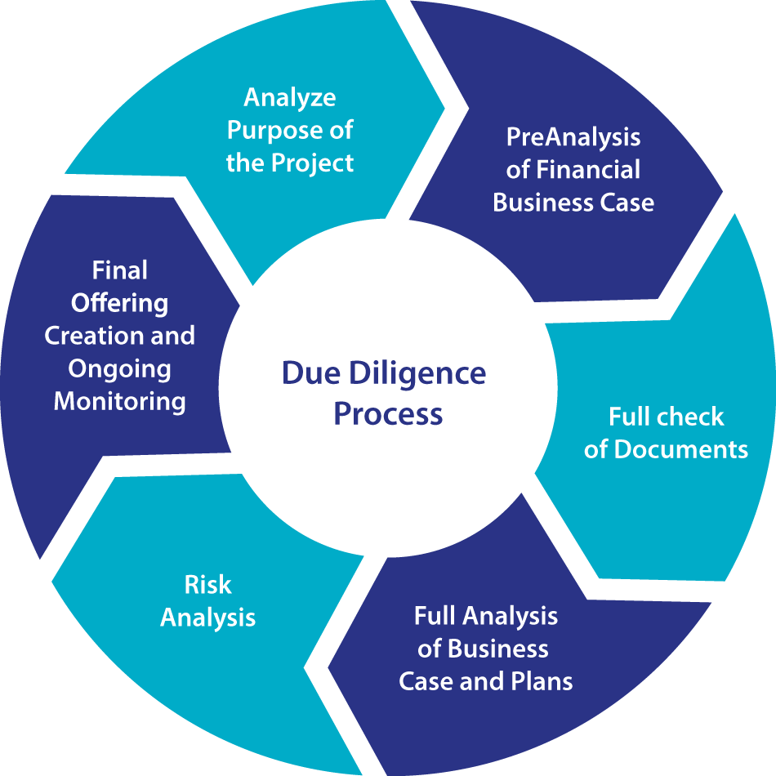
Due Diligence
Due diligence is the comprehensive investigation and analysis conducted by potential buyers or investors to assess the financial, legal, operational, and commercial aspects of a company before a transaction, such as an acquisition or investment, takes place.
It involves a thorough examination of a company's assets, liabilities, financial performance, contracts, legal compliance, intellectual property, customer base, and other relevant factors to identify risks, opportunities, and value drivers.

Slide 58
Due Diligence
Key stakeholders involved in due diligence typically include:
Investors
Lawyers
Financial Advisors

Slide 59
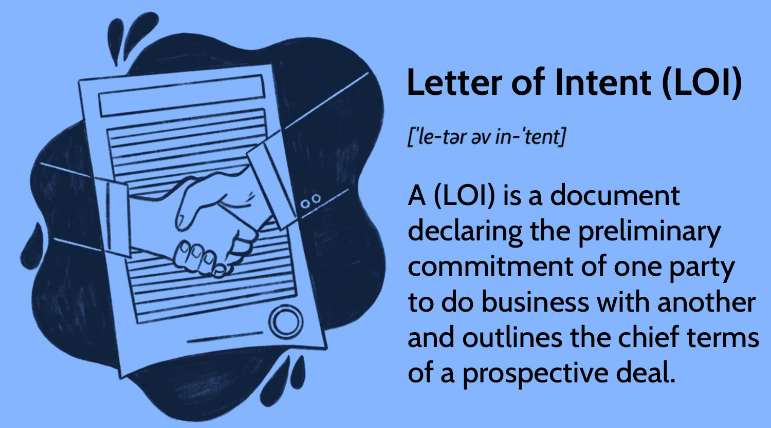
Letter of Intent (LOI)
A Letter of Intent (LOI), also known as a Memorandum of Understanding (MOU), is a non-binding agreement between a buyer and a seller that outlines the key terms and conditions of a proposed acquisition or transaction.
While not legally binding, an LOI serves as a starting point for negotiations and sets the framework for the subsequent definitive agreement.

Slide 60
Letter of Intent (LOI)
Key components typically included in an LOI are:
Price
Payment Terms
Due Diligence Timeline
Closing Date and Conditions
Confidentiality and Exclusivity

Slide 61
Acquisition Agreement
A legally binding contract outlining the terms of an acquisition.
Key components:
Purchase price
payment terms
warranties, and
indemnifications

Slide 62
Post-Acquisition Integration
Challenges: Integration challenges include cultural differences, system integration, and retaining key employees.
Strategies: Strategies for successful integration include effective communication, retention bonuses, and clear goals.

Slide 63
Going Public - IPO Process
An IPO is the process of issuing stock to the public to raise capital.
Key stakeholders: Underwriters, lawyers, accountants, and the company's management team are typically involved in an IPO.

Slide 64
IPO Process
Filing: Filing a registration statement with the SEC, including financial statements and other information.
Roadshow: A presentation by the company's management team to potential investors.
Pricing: Determining the IPO price and allocating shares to investors.

Slide 65
IPO Valuation
Methods: Valuation methods include discounted cash flow, comparable company analysis, and precedent transaction analysis.
Factors: Factors that can impact valuation include revenue, profitability, market size, and growth potential.

Slide 66
Post-IPO Life
Challenges: Challenges include increased regulatory compliance, public scrutiny, and maintaining growth.
Strategies: Strategies for success include effective communication, investor relations, and continued innovation.

Slide 67
Case Studies of Successful Exit Strategies

Slide 68

Instacart
Instacart is a grocery delivery and pickup service that was founded in 2012.
The company quickly gained popularity and expanded its operations to multiple cities across the United States.
In 2018, Instacart announced that it had raised $700 million in funding, bringing its valuation to $7.6 billion.

Slide 69
Instacart
In 2020, the company faced a number of challenges, including increased competition from other grocery delivery services, high operational costs, and declining sales.
In response, Instacart's leadership team decided to explore an exit strategy.

Slide 70
Exit Strategy
Instacart's leadership team decided to pursue a strategic acquisition by a larger company.
They identified several potential buyers, including retailers and technology companies, and began negotiations.
In November 2020, Instacart announced that it had agreed to be acquired by Walmart, the world's largest retailer, for $1.5 billion.
The acquisition allowed Instacart to expand its operations and reach a wider customer base, while also providing a return on investment for its shareholders.

Slide 71
Rationale
Instacart's decision to pursue an exit strategy was motivated by several factors.
The company was facing increasing competition from other grocery delivery services, such as AmazonFresh and Shipt, which were offering similar services and gaining market share.
Instacart's operational costs were high, and the company was struggling to achieve profitability.
The company's sales were declining, which made it difficult to sustain its growth and expansion plans.

Slide 72
Rationale
By pursuing an exit strategy, Instacart was able to achieve several objectives.
The acquisition by Walmart provided a return on investment for the company's shareholders, who had invested over $1.8 billion in the company since its founding.
The acquisition allowed Instacart to expand its operations and reach a wider customer base, which would have been difficult to achieve on its own.
The acquisition provided a strategic partnership with a larger company that could help Instacart navigate the challenges of the grocery delivery market.

Slide 73
Conclusion
Instacart's use of an exit strategy is a prime example of how a tech startup can use this tactics to achieve its objectives.
By identifying potential buyers and negotiating a strategic acquisition, Instacart was able to provide a return on investment for its shareholders, expand its operations, and achieve a strategic partnership with a larger company.
This case study highlights the importance of considering an exit strategy as a viable option for tech startups looking to achieve their long-term goals.

Slide 74
Souq.com
Souq.com was a Dubai-based e-commerce platform that was founded in 2005.
The company quickly grew to become one of the largest e-commerce platforms in the Middle East and North Africa, with millions of customers and thousands of sellers on its platform.
In 2017, Souq.com was acquired by Amazon for $580 million, marking one of the largest tech acquisitions in the region's history.

Slide 75
Exit Strategy: Acquisition by Amazon
Souq.com's exit strategy was to be acquired by a larger company, and Amazon was the perfect suitor.
Amazon had been looking to expand its presence in the Middle East and North Africa, and the acquisition of Souq.com provided the company with a ready-made platform and customer base.
For Souq.com, the acquisition provided an opportunity to tap into Amazon's vast resources and expertise, as well as access to a global customer base.

Slide 76
Factors Leading to the Successful Exit
Several factors contributed to Souq.com's successful exit:
Strong Market Position
Innovative Business Model
Strong Financials
Strategic Partnerships
Talented Team

Slide 77
Lessons Learned
Souq.com's successful exit provides several lessons for tech startups looking to follow a similar path:
Focus on Building a Strong Brand
Innovate and Differentiate
Build a Strong Financial Position
Establish Strategic Partnerships
Attract and Retain Talent

Slide 78
Conclusion
Souq.com's successful exit to Amazon is a testament to the company's strong market position, innovative business model, strong financials, strategic partnerships, and talented team.
The acquisition not only provided a successful exit for the company's shareholders but also marked a significant milestone in the growth of e-commerce in the Middle East and North Africa.
The deal also underscores the potential for tech startups in the region to achieve significant growth and success, and serves as an inspiration for other entrepreneurs looking to build and grow their own businesses.
Souq.com's successful exit serves as a reminder that with the right combination of vision, strategy, and execution, tech startups in the Middle East and North Africa can achieve great success and create value for their shareholders, customers, and the wider ecosystem.

